Slide 1
Database System

Slide 2
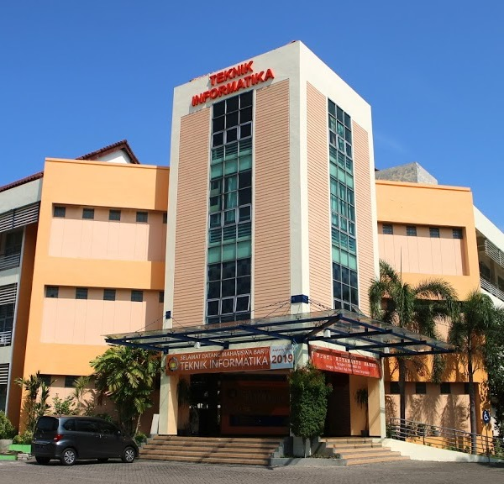
Nested Query

Slide 3
Outline
Nested Query
Location of the Subquery
Operator in Subquery

Slide 4
Nested Query
A SQL Select command that has another SQL Select command in it.
A nested query is a SQL Select command that has another SQL Select command in it.
The main query is the outer SQL select command (called the outer query)
A subquery is an SQL select command that is inside the main query (called the inner query).

Slide 5
Subquery
outer query
inner query
SELECT select_list
FROM table
WHERE expr operator (SELECT select_list
FROM table);
The subquery (inner query) is executed once before executing the main query (main query/outer query).
The result of the subquery is used in the main query

Slide 6
Example of Nested Query
SQL> SELECT ename
FROM emp
WHERE sal >
(SELECT sal
FROM emp
WHERE empno = 7566);
2975
ENAME
----------
KING
FORD
SCOTT

Slide 7
Location of Subquery
Subquery (Inner Query)
can be located at
After SELECT
After FROM
Condition of WHERE
Condition of HAVING

Slide 8
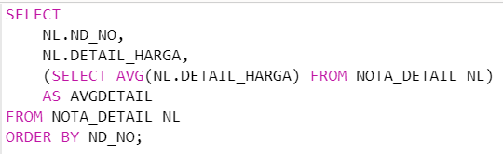
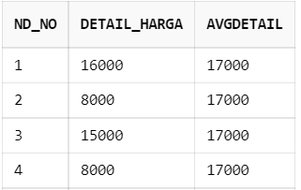
Subquery after SELECT

Slide 9
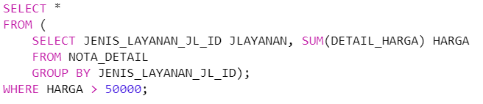
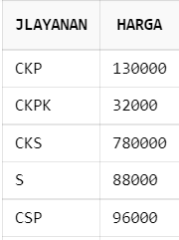
Subquery after FROM

Slide 10
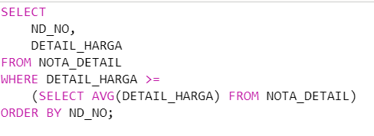
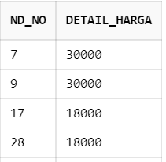
Subquery in Condition of WHERE

Slide 11
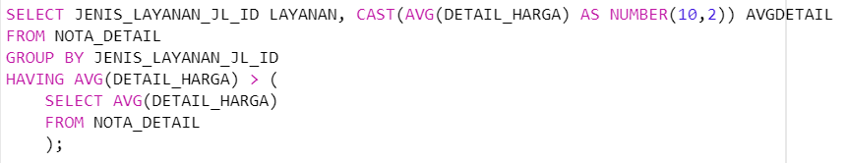
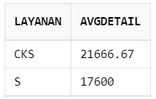
Subquery in Condition of HAVING

Slide 12
Operators on subquery
A subquery can return a single value or multiple rows of values

Slide 13
Single row subquery
Query that returns a single row of data from the SELECT command
Single row operator
= equal to
> greater than
>= greater than or equal to
< less than
<= less than or equal to
<> not equal to

Slide 14
Example of Single row subquery (1)
Show data on employees who have the same position as Smith.
SELECT last_name, title FROM employee WHERE title = ( SELECT title FROM employee WHERE last_name = ‘Smith’ );

Slide 15
Example of Single row subquery (2)
Displays data on employees who have below-average salaries.
SELECT last_name, title, salary FROM employee WHERE salary <
( SELECT AVG(salary) FROM employee );

Slide 16
Multiple row subquery
A subquery that returns more than one row of data is called a multiple row subquery
Multiple row operator
IN
NOT IN
ANY
ALL

Slide 17
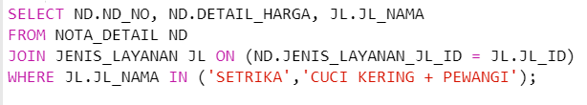
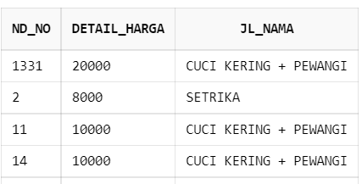
Example of Multiple row subquery (1)
Select nota_detail data that has “SETRIKA” or “CUCI KERING+PEWANGI” services

Slide 18
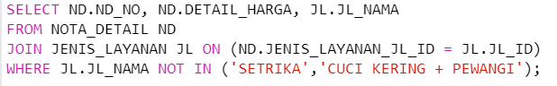
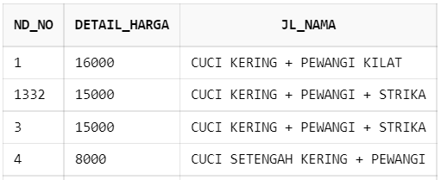
Example of Multiple row subquery (2)
Select nota_detail data that is not “SETRIKA” service or not “CUCI KERING+PEWANGI” service

Slide 19
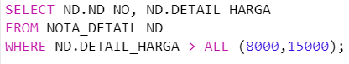
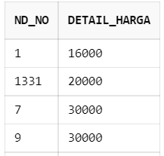
Example of Multiple row subquery (3)
Select nota_detail data whose price is above 8000 and 15000

Slide 20
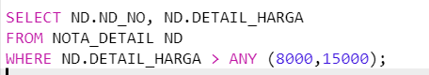
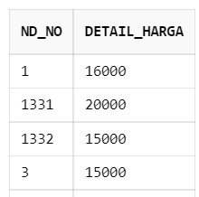
Example of Multiple row subquery (4)
Select nota_detail data whose price is above 8000 or 15000

Slide 21

- TERIMA KASIH -

